Slide 1
Introduction:Web Service !
A Web Service is can be defined by following ways: It is a client-server application or application component for communication. The method of communication between two devices over the network.communication. It is a collection of standards or protocols for exchanging information between two devices or application.

Slide 2
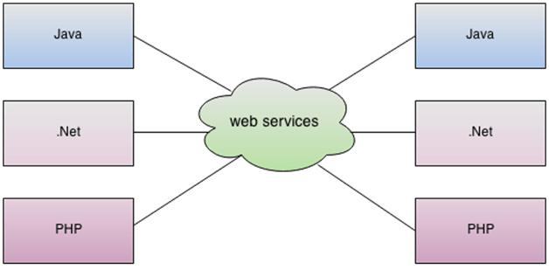
Let’s understand it by the figure given below:

Slide 3
As you can see in the figure, Java, .net, and PHP applications can communicate with other applications through web service over the network. For example, the Java application can interact with Java, .Net, and PHP applications. So web service is a language independent way of communication.

Slide 4
Types of web service:
There are several types of web services, including:
SOAP (Simple Object Access Protocol)
REST (Representational State Transfer)
GraphQL
WSDL (Web Services Description Language)

Slide 5
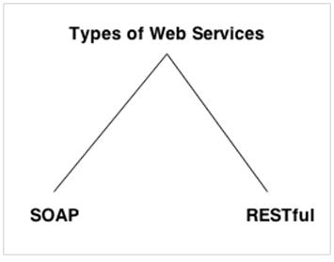

Slide 6
Features of Web Services
Web services are programming language independent. A Java application can consume a PHP web service.
Web services can be published over the internet to be consumed by other web applications.
Web-service is loosely coupled with the web service. So the web services can update or change its logic without affecting the consumer.

Slide 7
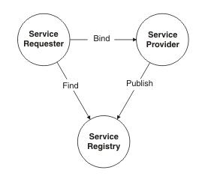
Architecture of Web Services
The web services architecture is based on interactions between three components: a service provider, a service requester, and an optional service registry.

Slide 8
The service provider:
The collection of software that provides a web service.
2.The service requester: The collection of software that is responsible for requesting a web service from a service provider.
3.The service registry: The service registry is a central location where service providers can publish their service descriptions and where service requesters can find those service descriptions.

Slide 9
Operations in a Web Service Architecture:
(Publish): In this operation, a service description must be published so that a service requester can find the service
(Find): In this operation, the service requestor directly retrieves the service description..
(Bind): In this operation, the service requestor calls or initiates an interaction with the service at runtime only using the binding details available in the service description to locate, contact, and call the service.

Slide 10
Advantages Of Web Service:
Business Functions can be exposed over the Internet
Web services have become increasingly valuable. That is to say, the web service can be located anywhere on the internet and provide the required functionality.
Reusability:
A single web service can be used simultaneously by several client applications.
Platform Independence:
Web services operate over standard internet protocols, enabling them to function on different platforms and devices, promoting flexibility and accessibility.

Slide 11
Disadvantages of Web Services:
Performance Issues:
Web services perform problems, especially when dealing with large volumes of data or complex process
2 .Dependency on Network:
Web services heavily rely on network connectivity. If the network experiences issues or downtime, it can disrupt communication between applications and services
3.Privacy Concerns:
Transmitting sensitive data over the internet using web services raises privacy concerns, especially if proper encryption and security measures are not implemented.

Slide 12
Web Service SOAP
SOAP (Simple Object Access Protocol) is a protocol for exchanging structured information in web services. It uses XML (eXtensible Markup Language) as its message format to facilitate communication between applications over a network.

Slide 13
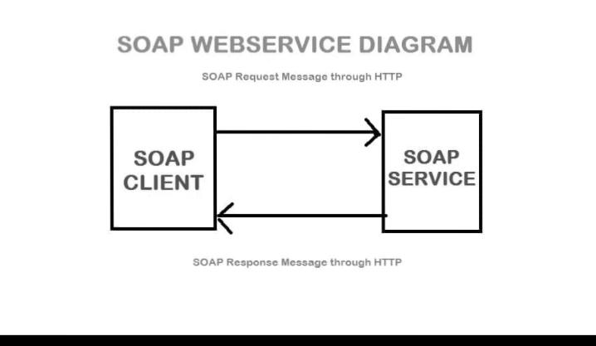
Working of web service SOAP

Slide 14
Components of SOAP
SOAP (Simple Object Access Protocol) consists of several key components: Envelope: The envelope is the outermost element of a SOAP message. It encapsulates the entire message and contains other elements like Header and Body. Header: The Header is an optional element within the SOAP Envelope
Body: The Body is a mandatory element within the SOAP Envelope. It contains the actual data being sent in the SOAP message.

Slide 15
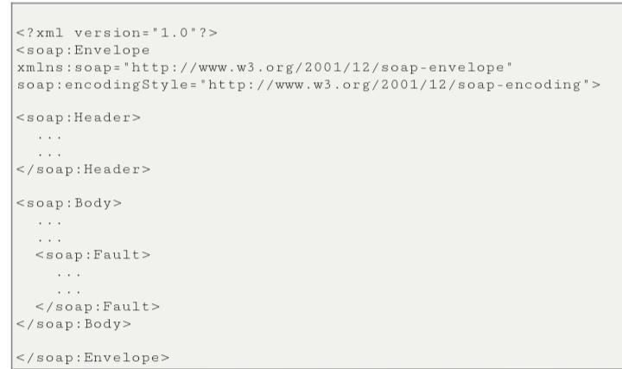
Syntax of web service SOAP:

Slide 16
Example of Soap message:
<soap:Header/> <soap:Body> <example:GetWeather> <example:City>New York</example:City> </example:GetWeather> </soap:Body> </soap:Envelope> In this example, a SOAP envelope contains a request to get weather information for the city of New York. The GetWeather operation is defined in the example namespace, and the specific data, in this case, the city name, is included within the SOAP body.

Slide 17
Advantages of Soap Web Services:
WS Security:
SOAP defines its own security known as WS Security. Language and Platform independent:
SOAP web services can be written in any programming language and executed in any platform.

Slide 18
Disadvantages of Soap Web Services
Slow:
SOAP messages can be complex .So it is slow and consumes more bandwidth and resource. WSDL –Based : SOAP uses WSDL and doesn’t have any other mechanism to discover the service.
Human Readability:
SOAP is not as human-readable as other formats like JSON

Slide 19
Thank you!

